Slide 1
Recovered Paper Market Update
With Johnathan Gold, Recovered Paper Market Specialist, Davis Index.
Presentation by Huban Kasimi, Recycling Materials Editor,
Davis Index
January 17, 2024

Slide 2
DISCLAIMER
Davis Index Private Limited (Davis) makes no representations or warranties or other assurance, express or implied, about the accuracy or suitability of any information in this presentation and related materials distributed at or in connection with this presentation.
The information or opinions contained in this presentation are provided on an “as is” basis without any warranty, condition or other representation as to its accuracy, completeness, or suitability for any particular purpose and shall not confer rights or remedies upon the recipients of this presentation or any other person. Data and information contained in the presentation come from a variety of sources, some of which are third parties outside Davis’ control and some of which may not have been verified.
All analysis and opinions, data, projections, outlooks and forecasts provided may be based on assumptions that are not correct or which change, being dependent upon fundamentals and other factors and events subject to change and uncertainty; future results or values could be materially different from any forecast or estimates described in the presentation.
To the maximum extent permitted by law, Davis expressly disclaims any and all liability for any direct, indirect or consequential loss or damage, claims, costs and expenses, whether arising in negligence or otherwise, in connection with access to, use or application of these materials or suffered by any person as a result of relying on any information included in, or omission from, this presentation and related materials or otherwise in connection therewith.
The information contained in this presentation and related materials is provided for general information purposes only and should not be construed as legal, tax, accounting or investment advice or the rendering of legal, consulting, or other professional services of any kind. Users of these materials should not in any manner rely upon or construe the information or resource materials in these materials as legal, or other professional advice and should not act or fail to act based upon the information in these materials.

Slide 3
Outlook and review
Exports
01
03
02
04
Intro
Recycled fiber price trends

Slide 4
Introduction
01

Slide 5
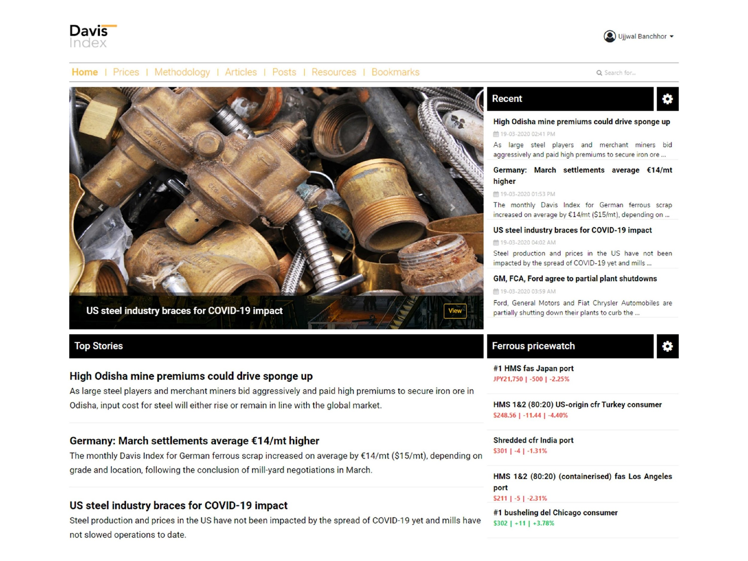
Designed specifically for the global recyclables supply chain
Ferrous, non-ferrous metals and recovered paper pricing
News and analysis from across the globe; hyper-local coverage
Around 1,600+ proprietary price indexes, no assessments. All follow IOSCO compliance.
Exchange futures for metals, energy and currency from LME, CME, and Nymex.
65+ full-time experts spread globally, over 100 years of industry experience
Teams in the US, Canada, Mexico, India, Germany
www.davisindex.com

Slide 6
1
Data Mining
Data processing
2
INDEX PROCESS
No guesswork.
Just pure data.
3
Data Rationalization
Data Indexation
(Volume-weighted)

Slide 7
PLATFORM
Web
PDF
Mobile
Davis Index delivers all its price indexes, analysis, news, and research through a highly customizable tech platform: davisindex.com
Davis Index delivers two reports and two newsletters each day for metals; one at the end of the Asia day, and a second at the end of US day. The recovered paper newsletter is delivered weekly on Thursday.
All Davis Index price indexes, analysis, news and research are also delivered to dedicated mobile apps built for Android and iOS platforms.

Slide 8
MARKET COVERAGE
Aluminium
Primary | India, USA
Recycled domestic | India, USA
Recycled import | China, India
Recycled export | USA
Secondary alloy | China, India, Japan, USA
Recycled steel
Domestic | Bulk imports | Bulk exports | Container import
Bangladesh | Bangladesh | Belgium | Bangladesh
Canada China | Ecuador | Baltic Sea | India
Germany | Egypt | Black Sea | Indonesia
India | Greece | Germany | Pakistan
Japan | India | Netherlands | South Korea
Malaysia | Indonesia | UK | Taiwan
Mexico | Kuwait | USA | Vietnam
Pakistan | Malaysia
South Korea | Mexico | Dock prices | Container export
Spain | Pakistan | Belgium | Belgium
Taiwan | Peru | Netherlands | Japan
Thailand | Saudi Arabia | Russia | Netherlands
Turkey | South Korea | UK | UK
UK | Taiwan | USA | USA
USA | Turkey
Vietnam
Freight
Container | Bulk
Bangladesh | Brazil-US
China | Europe-Turkey
India | Turkey-US
Indonesia | UK-Turkey
Malaysia | US-Bangladesh
Pakistan | US-Korea
South Korea | US-Turkey
Taiwan
Thailand
Vietnam
Recovered paper
Domestic
USA
Import
India
Export
USA
Recycled Stainless steel, inconel, hastelloy
Import | India, Taiwan
Domestic | USA
Copper/brass
Primary | India, USA
Recycled domestic | India, USA
Recycled import | China, India, Pakistan
Recycled export | USA
Feedstocks
Basic Pig Iron
Black Sea
Italy
US
HBI
USA
NPI
USA
Sponge iron
India
Lead
Primary | India, USA
Recycled domestic | India, USA
Ingot | India
Zinc
Primary | India, USA
Alloy | India, USA
import | India
domestic | India, USA
Steel
Billet domestic | Bangladesh, India, Pakistan
Rebar domestic | Bangladesh, India, Pakistan
8

Slide 9
Recovered Paper Outlook
02
9

Slide 10
Demand, Supply and Price Movements Expected this Year
Domestic collection rates in the US are likely to remain low until the end of Q1 2024.
Demand for recycled fiber is anticipated to be adequate within the US.
Domestic supply will remain undisrupted as new mills come online after H1 2024.
Both OCC and DS OCC need to improve domestically for mills so the current surplus inventory can be moved out.
In terms of exports, tonnages to the Far East will remain strong.
Shipments to India may strengthen by Q2 2024.
Prices of export-grade Baled #11 Old Corrugated Containers (OCC) and Baled #12 Double Sorted Old Corrugated (DS OCC) are anticipated to ‘normalize’ in the near-term.
10
Notes:
Talk about this slide before the first question.

Slide 11
Corrugated Prices and Trends
03
11

Slide 12
#11 OCC US domestic
The monthly Davis Index for Baled #11 Old Corrugated Containers (OCC) rose $7/nt to $143/nt fob Northeast seller dock, $10/nt to $123/nt fob Los Angeles seller dock and $10/nt to $120/nt fob seller dock in the Midwest. Corrugated prices have begun 2024 on a high note after an underwhelming close in December. Generation is still below expectations but adequate supply of recycled fiber is keeping prices steady.
12

Slide 13
#11 Old Corrugated Containers export
The weekly Davis Index for #11 Old Corrugated Containers slipped by $3/nt to $167/nt fas New York and $176/nt fas Los Angeles, respectively on Jan 11. Prices on both coasts appear to be recovering in 2024 after a period of softening around the middle of last year. The grade has held its own in Los Angeles reaching a six-month high of $179/nt fas on Jan 4. Some strengthening is expected out of the West Coast as freight differentials to the Far East become firmer. Prices of OCC on the East Coast have lagged since July. The grade was at its highest point in October at $174/nt fas New York.
13

Slide 14
US’ Recovered Paper Exports
05
14

Slide 15
US recovered paper exports
US recovered paper trade continued to wane between January and November, with exports and imports down 13pc and 19pc, respectively.
Total shipped volumes to other countries were 13.11mn nt compared with 15.01mn nt annually for the period.
In November the US exported 1.16mn nt of recovered paper, down 15pc against 1.38mn nt in the same month in 2022.
Los Angeles was the busiest port, handling 36,883nt, accounting for 16pc of the total exports from the West Coast.
15

Slide 16
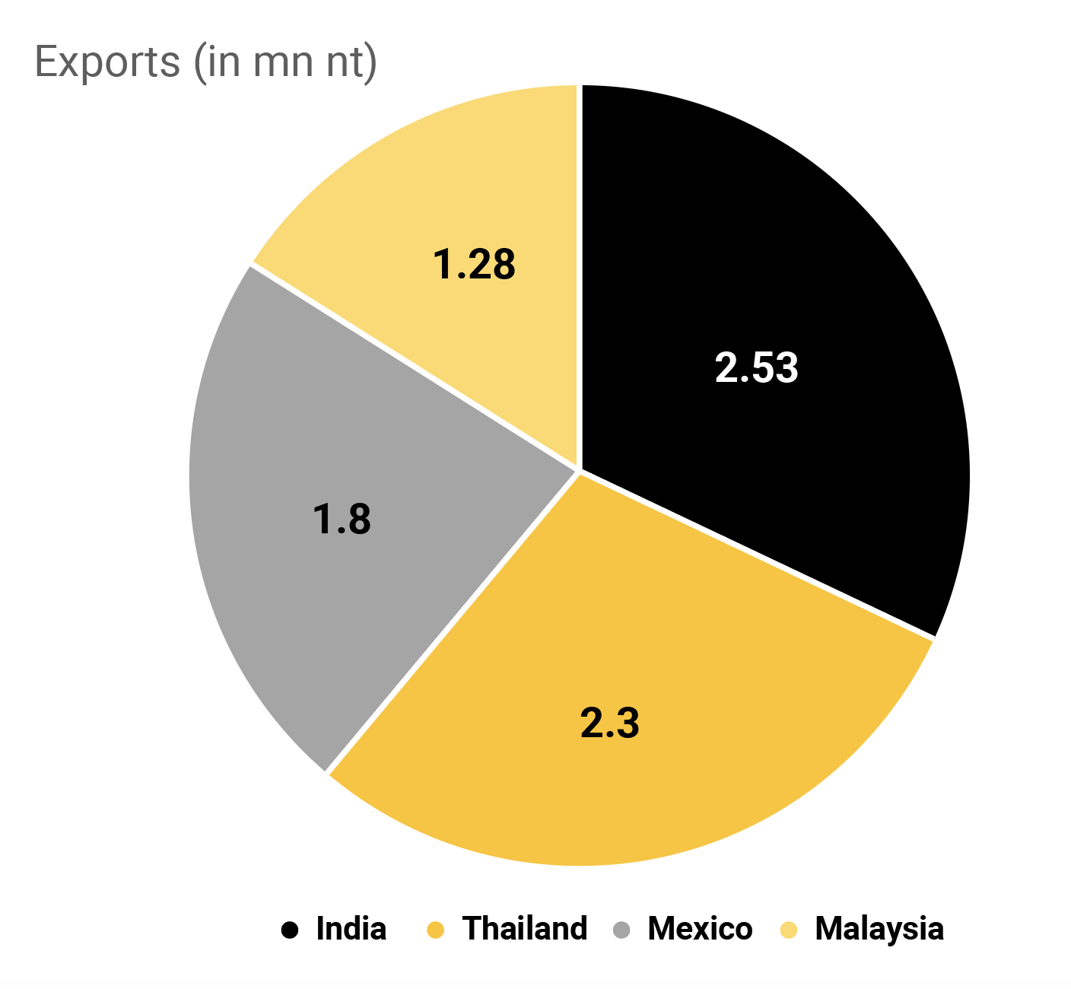
Top five buyers of the US’ recycled paper
India remains the top buyer but with 31pc lower shipments at 2.53mn nt between January and November against 3.7mn nt in the prior-year period. In October volumes to India fell 4pc to 182,962nt from 190,224nt in the year-ago month.
Malaysia, Thailand, Vietnam, and Mexico continue to be the other top buyers of US’ recycled paper and pulp.
16

Slide 17
SCRAP THE REST
17

Slide 18
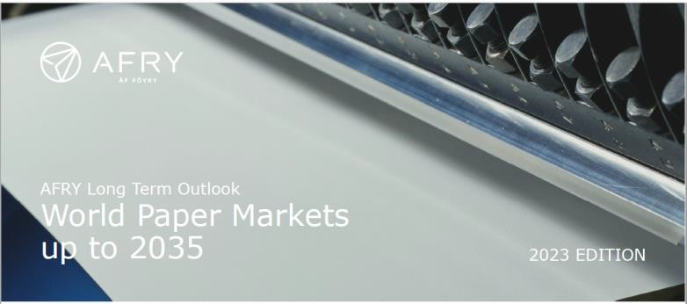
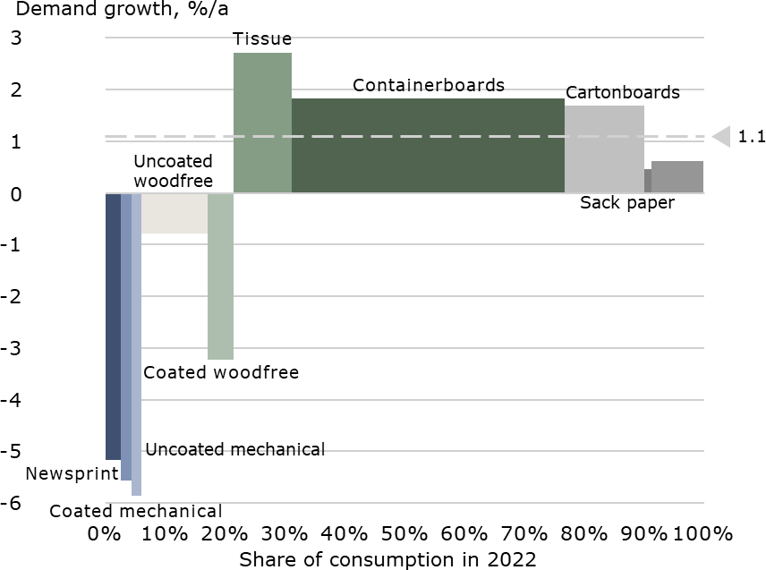
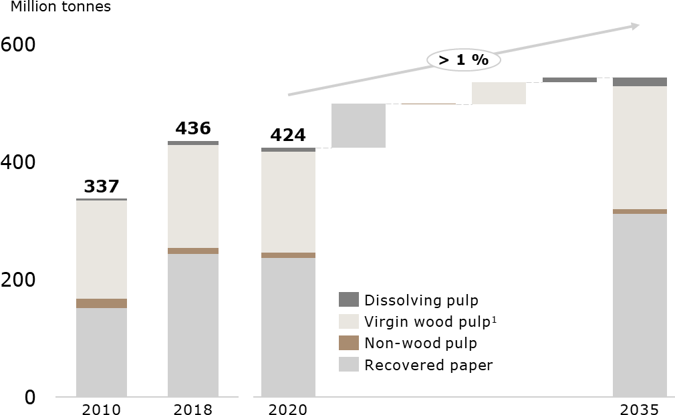
Fundamentals for continued long-term growth exist
MARKET PERFORMANCE | AFRY WORLD PAPER MARKETS MULTICLIENT: PAPER AND BOARD DEMAND THROUGH 2035
2023 Edition
Global Long-term demand growth by grade 2022-2035
Global papermaking fiber and specialty pulp consumption 2022-2035
− Global demand for RCP is expected to grow significantly
from 2020 to 2035 (>70 Mt)
1 2023-12-22 | COPYRIGHT AFRY AB | WORLD PAPER MARKETS UP TO 2035 | 2023 EDITION ISRI WEBINAR

Slide 19
North America Paper and Packaging Industry Dashboard
MARKET PERFORMANCE | 1Q 2024 EXPECTATIONS
Product | Market size (MM tons) | 1Q 2024 Expected | 23Q3 v. 22Q3 (y-o-y%) | 2022 v. 2021 | Pre-pandemic (17-19 CAGR)
Corrugated box | 36 |  | -3% | -4% | +1%
Folding cartons | 8 |  | -16% | +3% | 0%
Food service board | 2 |  | -3% | +9% | +4%
Tissue | 10 |  | +1% | flat | +3%
Publication papers | 4 |  | -34% | +5% | -10%
Uncoated freesheet | 5 |  | -27% | +4% | -4%
Sources: AF&PA, PPPC, Public Companies Quarterly Reports; | Note: Publication papers inclusive of CM, UM, CFS. North American numbers.
2 1/15/2024 COPYRIGHT AFRY AB | PULP AND PAPER DASHBOARD

Slide 20
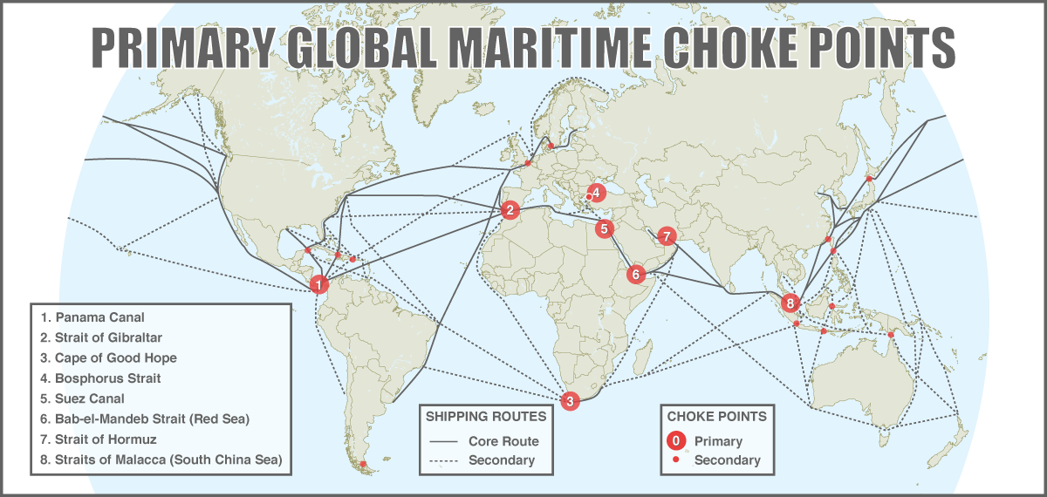
Suez Canal Trade Flow by James Derrico

Slide 21
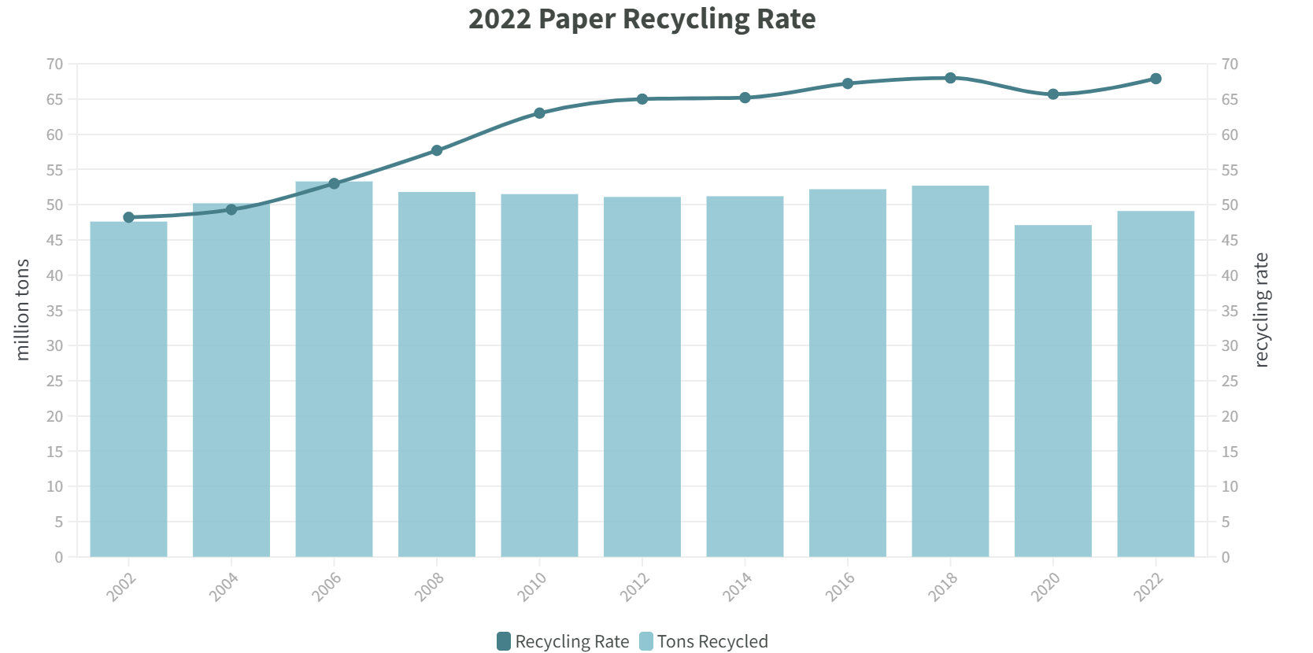
Recycling rate vs Tonnage by James Derrico

